Slide 1
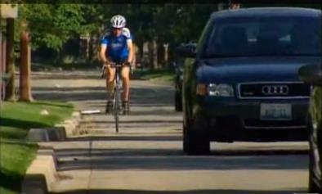

Module 3.4.1
Bicycle Awareness
Montana Teen Driver Education and Training
Notes:
REVISED 2018

Slide 2
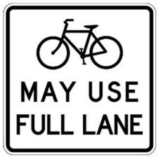
Share the road. Drive with courtesy.
Drivers can cross the yellow centerline to pass a person on a bicycle. Slow down and wait until it is safe to pass.
MCA 61-8-326

Slide 3
Montana law requires motorists to operate their vehicles in a
careful and prudent manner
without endangering the
life, limb, property or other rights of people entitled to use the highways. MCA 61-8-302

Slide 4
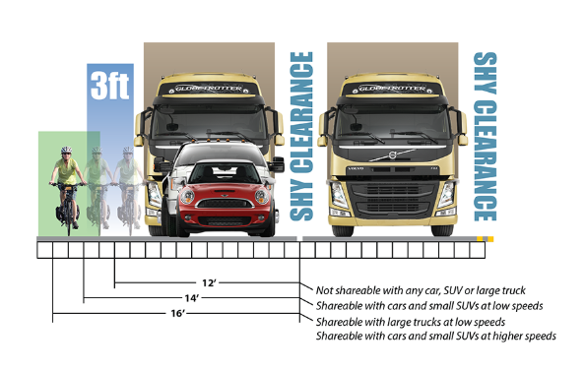
Share the lane, move over or slow?
Consider
Lane width
Pavement conditions
Frequency of intersections and driveways
Sight line obstructions
Speed of traffic – faster traffic requires more passing clearance and greater lane width to safely share
https://cyclingsavvy.org/lane-width-space/

Slide 5
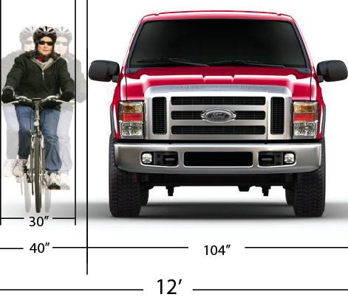
Space Required for Safe Passing
Bus, truck, van and large SUV drivers should not pass within the same lane as a bicyclist.

Slide 6
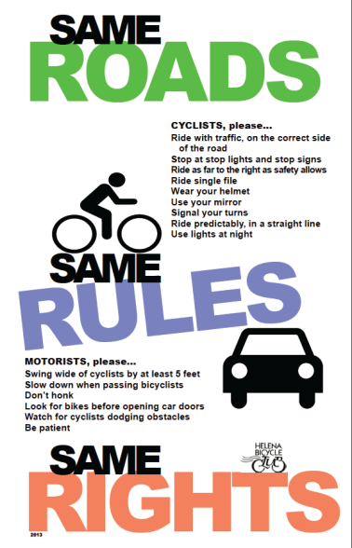
See Bicycle Traffic MCA 61-8-605

Slide 7
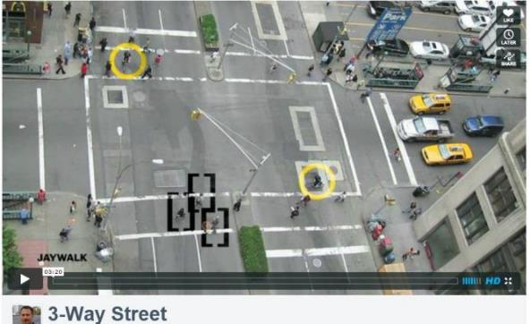
3-Way Street
https://vimeo.com/24572222
Notes:
THIS VIDEO IS ALSO IN THE MODULES “VIDEOS” FOLDER.
3-Way Street by Ron Gabriel
Music: Peter Gunn Theme by Art of Noise featuring Duane Eddy
This video is also available as an MP4 file upon request (it is very large).
Also: http://www.youtube.com/watch?v=RjrEQaG5jPM - India Traffic Chaos

Slide 8
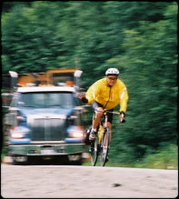
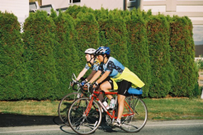
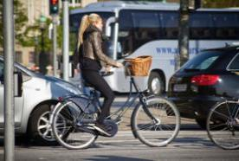
Driver-Bicyclist Safety Quiz

Slide 9
1. In what direction should a bicyclist ride?
Ride against the traffic.
Ride with the traffic.
Depends on whether it’s a one-way or two-way street.
It doesn’t matter which direction a bicyclist rides.

Slide 10
B. Ride with the traffic.
The bicyclist will:
  be more visible
  be more predictable
  sometimes move at similar speed as vehicles.
And it’s the law.

Slide 11
2. What is a safe distance for drivers to pass a bicyclist going in the same direction?
One or two feet.
More than five feet.
At least 10 feet.
15 feet or more.

Slide 12
B. More than five feet.
The bicyclist needs space for possible road obstructions.
Children may be unpredictable and need even more than five feet.

Slide 13
3. When a driver approaches a bicyclist from the rear, what should he do?
Blast the horn.
Race the engine.
Shout at the bicyclist.
None of the above.

Slide 14
D. None of the above.
Any of these can distract a cyclist and may cause a crash.
These options are neither courteous or considerate.

Slide 15
4. Where should bicyclists always ride?
On a sidewalk.
Hugging the side of the road no matter what.
As close to the side of the road as judged safe by the bicyclist.
In the same lane as traffic.

Slide 16
C. Ride as close to the side of the road as judged safe by the bicyclist.
However, there may be good reasons for a bike to “take the lane” for making a left turn, dodging road debris, or needing extra space.
Be prepared to share the entire road with bicyclists, if needed.

Slide 17
5. True or False:
Bicyclists have the legal right to ride on the road.
6. True or False:
Bicyclists should use only designated bike lanes and bike paths.

Slide 18
5. True
State law permits bicyclists to ride on roads and streets as long as they follow all the rules.
6. False
Because of limited designated bike paths, bicyclists must ride alongside vehicles on roads and streets.

Slide 19
7. At a stop sign or traffic light before proceeding, a driver should:
Look for cars approaching from the left, right and straight ahead.
Look for pedestrians on sidewalks and about to cross the street.
Look for bicyclists approaching on the road and the sidewalk.
All of the above.

Slide 20
D. All of the above.
Bicyclists, pedestrians and other road users are often not seen by drivers, so extra caution must be given.
Be aware of the unique position and behavior of bicyclists to minimize the risk of a car-bike crash.

Slide 21
8. A driver should always be alert to the possibility of a bicyclist:
Riding into the street from a driveway or side street.
Riding alongside parked cars.
Riding against the traffic flow.
All of the above.

Slide 22
D. All of the above.
Bicyclists can be unpredictable.
They may swerve to avoid a hazard you cannot see.
Be aware and alert in all situations.

Slide 23
9. True or False:
Drivers and bicyclists follow different traffic rules.
10. True or False:
Drivers always have the right of way when bicyclists are on the road.

Slide 24
9. False
Sharing the road means sharing all the rules.
10. False
See above. Standard right-of-way rules apply.

Slide 25
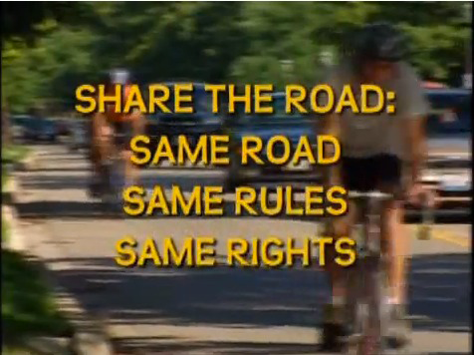
Bicycle Safety Video
Drivers’ Perspective
http://www.youtube.com/watch?feature=player_detailpage&v=S1PXvxh_6MI (Length: 6:51)
Notes:
Refer to the Teacher’s Video Guide in the Lesson Plans folder to get the most out of this video in the classroom.
Source: League of Illinois Bicyclists, Illinois Department of Transportation - 2009

Slide 26
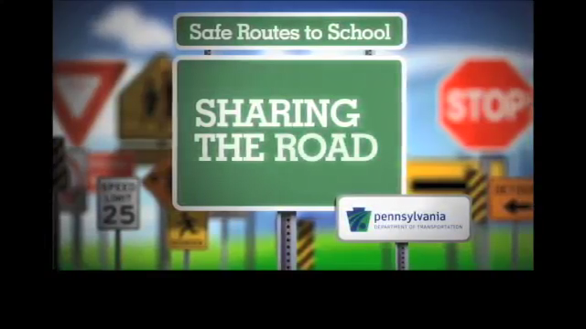
Sharing the Road Video
Bicyclists’ Perspective
https://www.youtube.com/watch?v=pW9EsY1RHuQ
Notes:
VIDEO IS 6 MINUTES LONG.

